Slide 1




XC Safety-Security-Reliability Academy 2025
03/06/2025
Notes:
Good afternoon and welcome to my presentation entitled: "Germany – Beer, Sausages, and Vulnerabilities.“
The title may sound humorous at first—and that's intended—but it conceals a serious topic: the vulnerability landscape in Germany in the context of cybersecurity.
So let's take a short but insightful journey through Germany's digital vulnerabilities together—with a wink, but with the necessary seriousness.

Slide 2
DEUTSCHLAND - BIER, WURST UND SCHWACHSTELLEN
Agenda
Common Attack Vectors
Vulnerability
Portuguese landscape
Page 2

Slide 3





DEUTSCHLAND - BIER, WURST UND SCHWACHSTELLEN
Disclaimer & Legal Considerations
Presentation is solely for educational and awareness purposes.
Live content may be unpredictable and potentially inappropriate for some viewers.
Users must check the legality of OSINT tools and methods in their country.
This presentation is not related to my work or employer.
images: Flaticon.com
Page 3

Slide 4

DEUTSCHLAND - BIER, WURST UND SCHWACHSTELLEN
Disclaimer & Legal Considerations
German Law
Bundesgesetzblatt (link)
Bundesnetzagentur (link)
Organizations
BSI – Bundesamt für Sicherheit in der Informationstechnik (link)
Incident Reporting (link)
CERT-Bund (link)
Bundeskriminalamt (link)
Generalstaatsanwaltschaft (link)
Page 4

Slide 5

DEUTSCHLAND - BIER, WURST UND SCHWACHSTELLEN
Disclaimer & Legal Considerations
ARTIFICIAL
INTELLIGENCE
Was heavily used for this presentation
Use available technologies but check facts.
Always check facts.
AI is more than ChatGPT. Grok, Claude, …
Use them all.
Page 5
Notes:
It's crucial to understand the ethical implications and legal boundaries when gathering information from open sources. This context will help the audience appreciate the responsible use of OSINT techniques in uncovering information without infringing on privacy or legal rights.

Slide 6

DEUTSCHLAND - BIER, WURST UND SCHWACHSTELLEN
$whoami
👓 Pedro Vieira
🔐 Cybersecurity Engineer
🕵️ OSINT
✒️ Full stack developer
👨‍🏫 Public Speaker
Page 6

Slide 7
DEUTSCHLAND - BIER, WURST UND SCHWACHSTELLEN
Vulnerability
Definition and Statistics
Page 7

Slide 8


DEUTSCHLAND - BIER, WURST UND SCHWACHSTELLEN
Vulnerability - Vulnerability vs incident
Logged In Remote Access
"A weakness in the computational logic (e.g., code) found in software and hardware components that, when exploited, results in a negative impact to confidentiality, integrity, or availability."
National Vulnerability Database - https://nvd.nist.gov/vuln
Vulnerability | Incident
Open door
Unauthorized access
images: Flaticon.com
Page 8
Notes:
Vulnerability - Known weakness in the system that can be exploited
Incident - Exploitation of the existing vulnerability

Slide 9
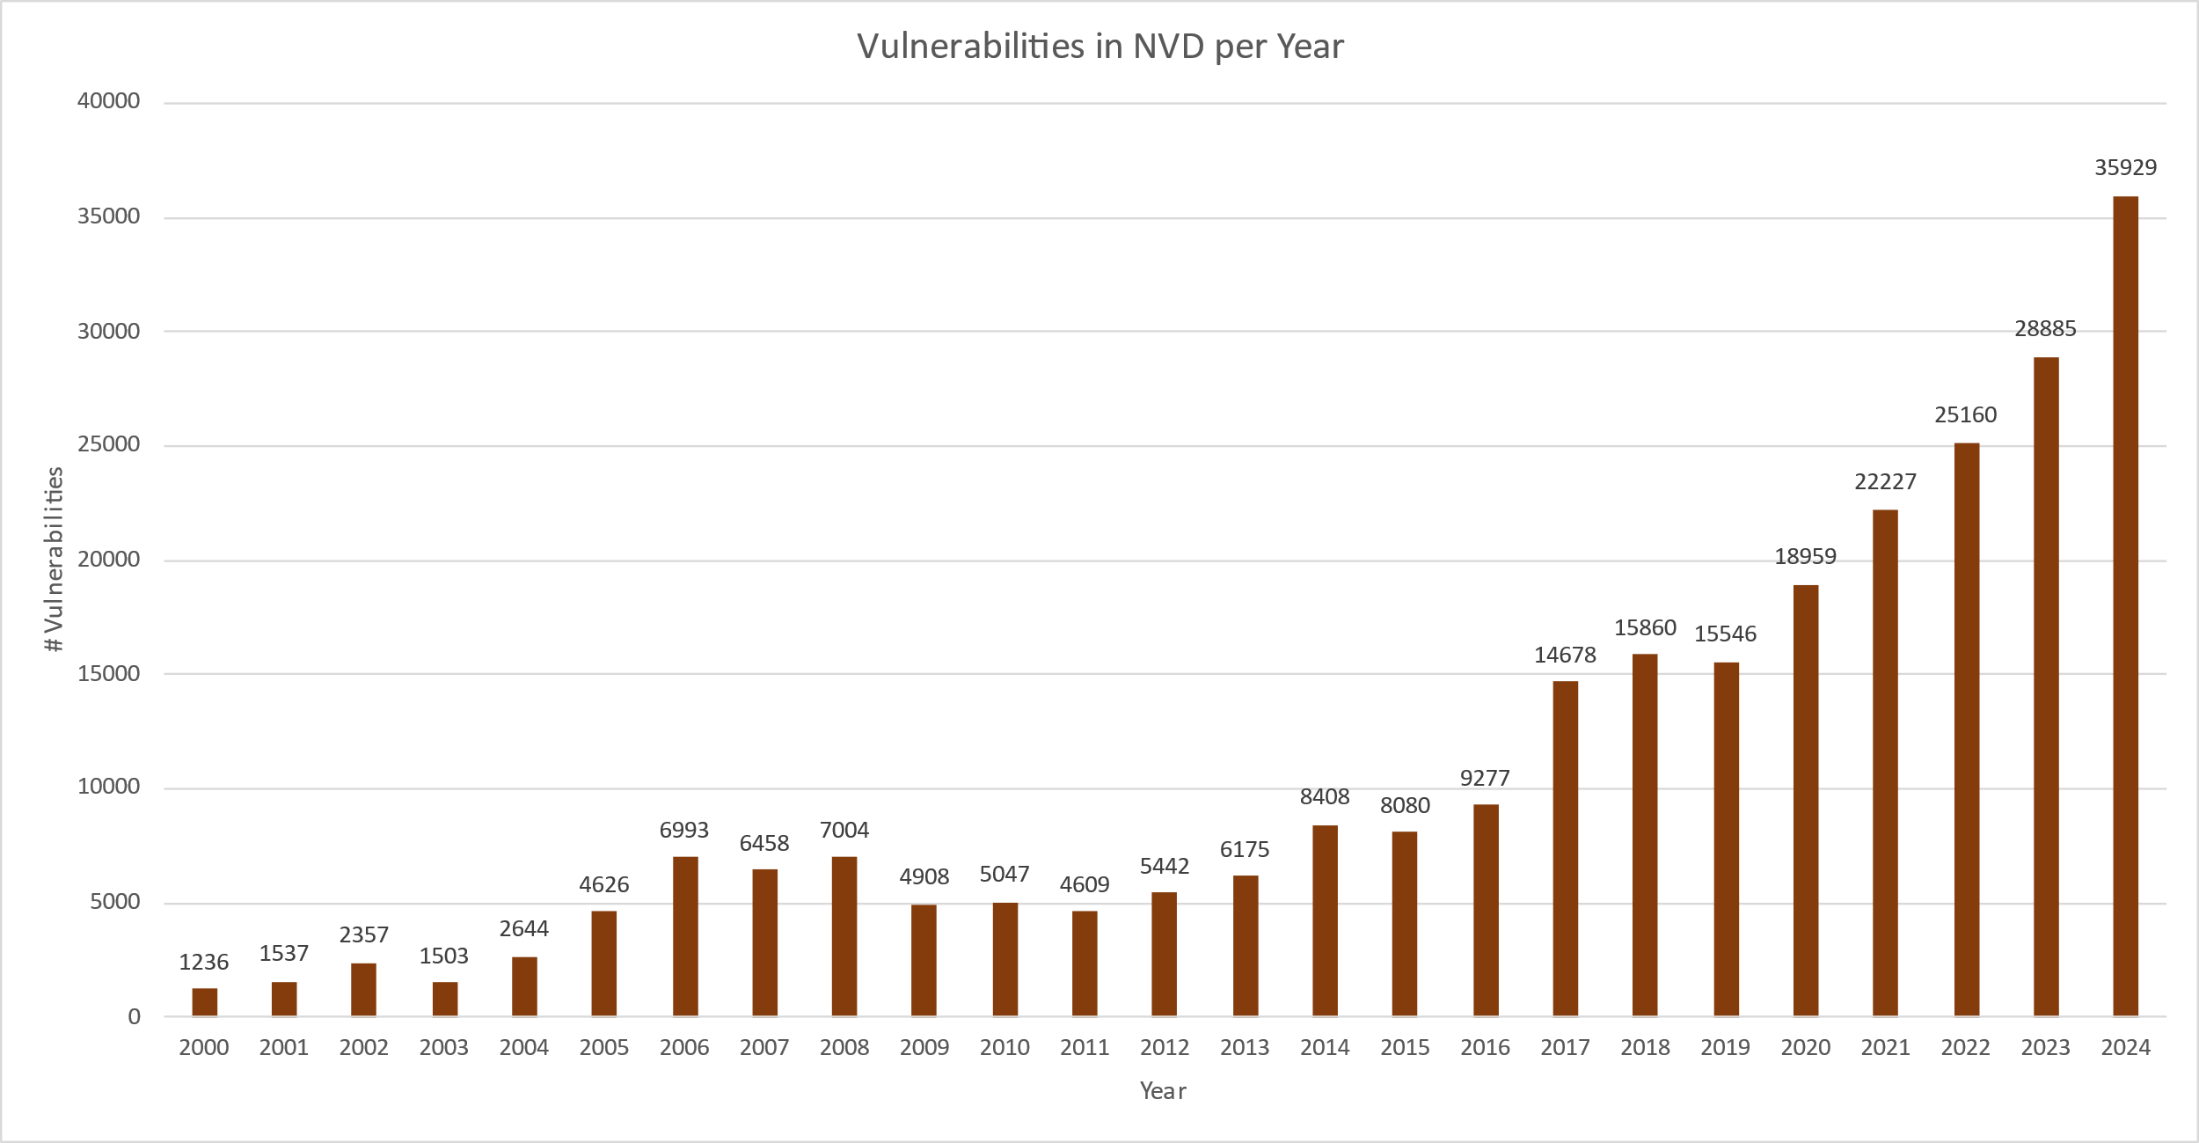
DEUTSCHLAND - BIER, WURST UND SCHWACHSTELLEN
Vulnerability - Statistics by Year
Total known vulnerabilities
263.548
Source NVD 29/05/2025
Page 9

Slide 10
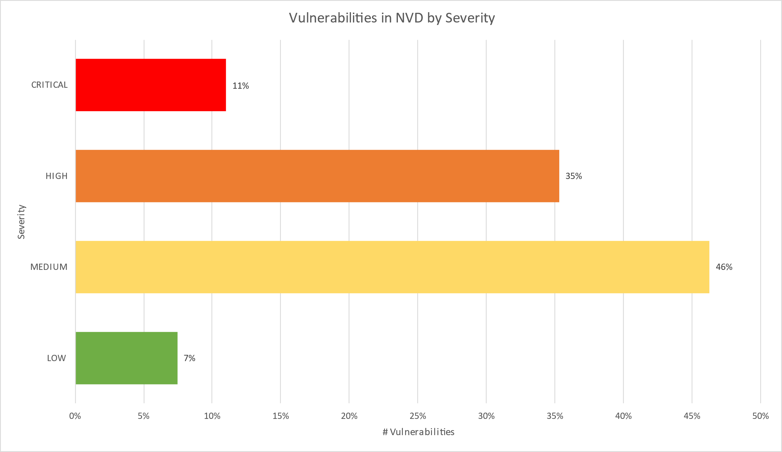
DEUTSCHLAND - BIER, WURST UND SCHWACHSTELLEN
Vulnerability - Statistics by Severity
Source NVD 29/05/2025
Page 10
Notes:
High and Critical amounts to almost 50% of all vulnerabilities

Slide 11
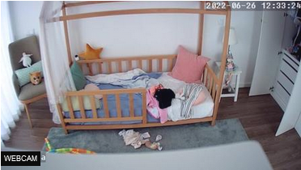
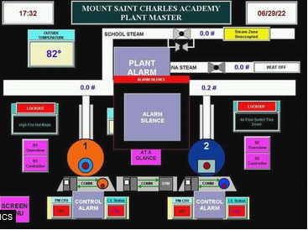
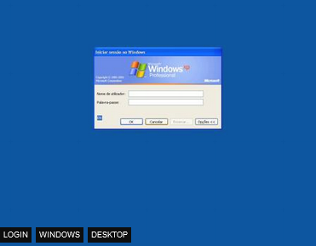
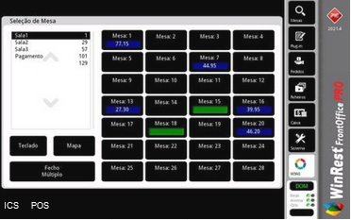
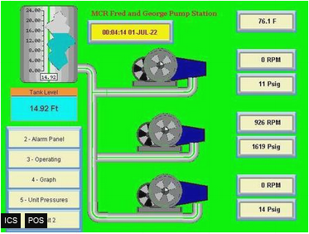
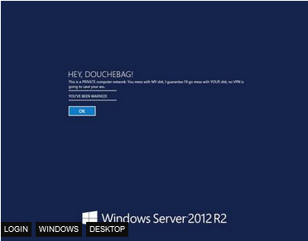
DEUTSCHLAND - BIER, WURST UND SCHWACHSTELLEN
Vulnerability - Examples from Shodan.io
Default/No Password | Industrial Control Systems | Vulnerable Systems
Page 11

Slide 12
DEUTSCHLAND - BIER, WURST UND SCHWACHSTELLEN
Common Attack Vectors
Easy-Peasy
Page 12

Slide 13
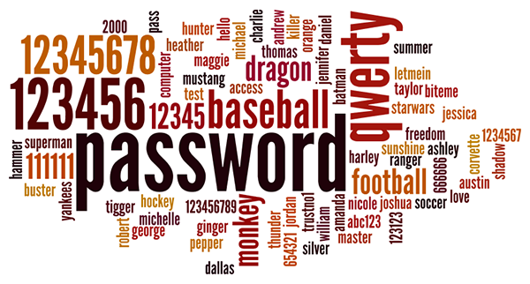
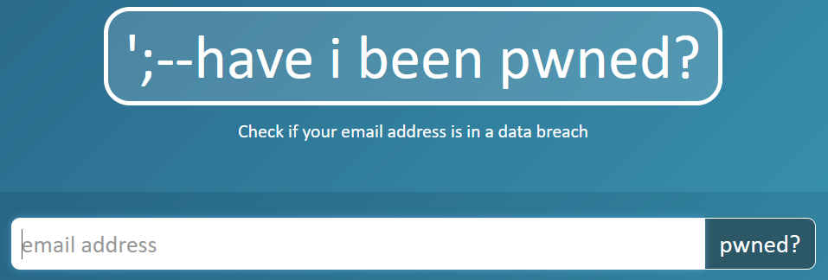
DEUTSCHLAND - BIER, WURST UND SCHWACHSTELLEN
Common Attack Vectors - Credentials
Insecure | Compromised/Leaked
No password Default credentials (admin/admin) Weak passwords Reused passwords | Hacked legitime sites leaked user information and credentials Mother of all breaches reveals 26 billion records
Page 13
Notes:
rockyou.txt contains 14,341,564 unique passwords, used in 32,603,388 accounts.
https://www.troyhunt.com/the-773-million-record-collection-1-data-reach/

Slide 14
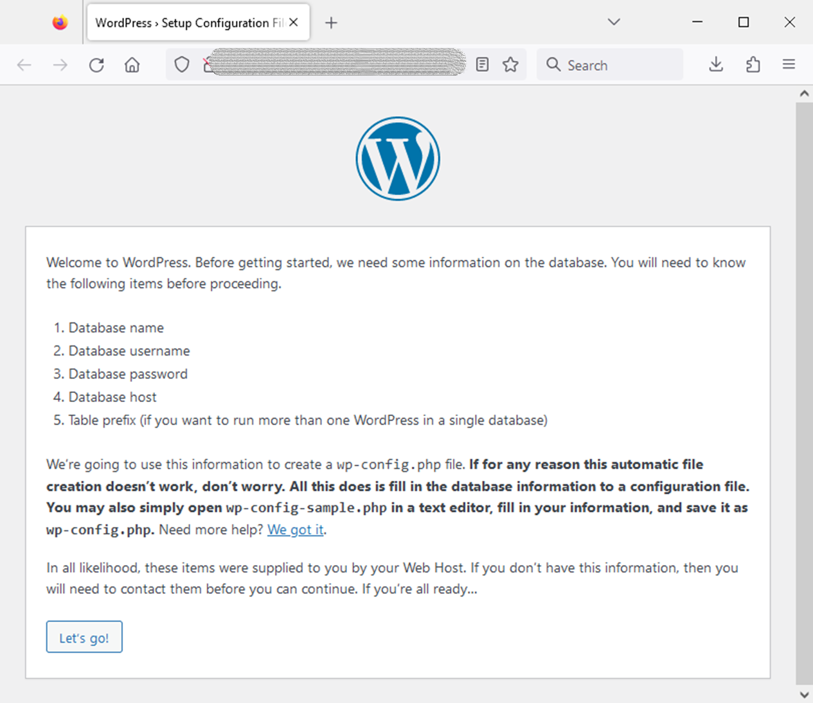
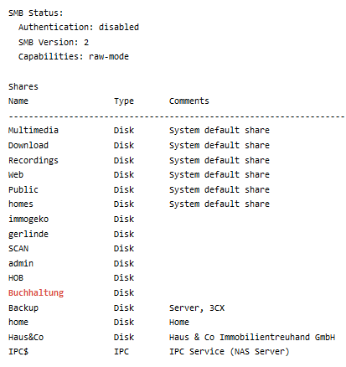
DEUTSCHLAND - BIER, WURST UND SCHWACHSTELLEN
Common Attack Vectors - Misconfiguration
Shared Folder – Authentication disabled | WordPress site – Configuration available
Accounting
Page 14
Notes:
https://www.shodan.io/search?query=contabilidade+port%3A445
Shared folder
Authenticated disabled
World accessible

Slide 15
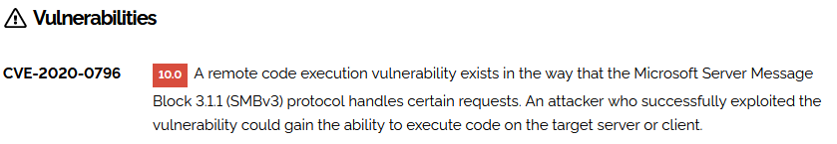

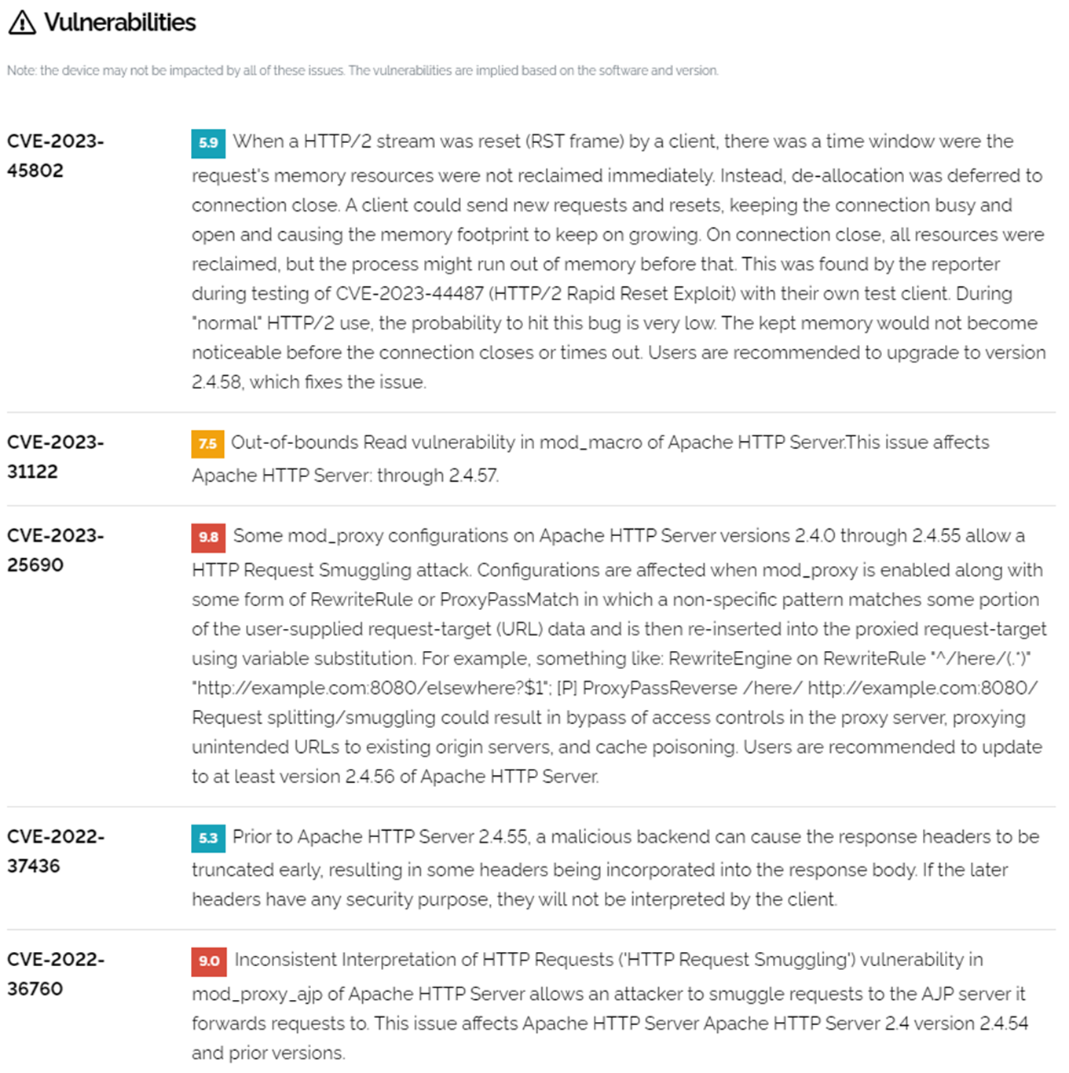
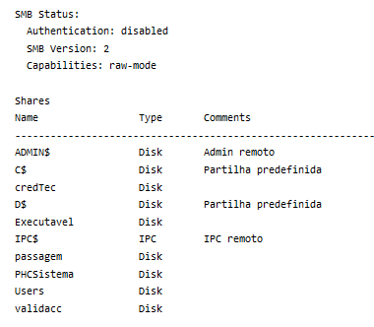
DEUTSCHLAND - BIER, WURST UND SCHWACHSTELLEN
Common Attack Vectors - Software Vulnerabilities
Shared Folder - Remote Code Execution | Website – Several vulnerabilities
Page 15

Slide 16
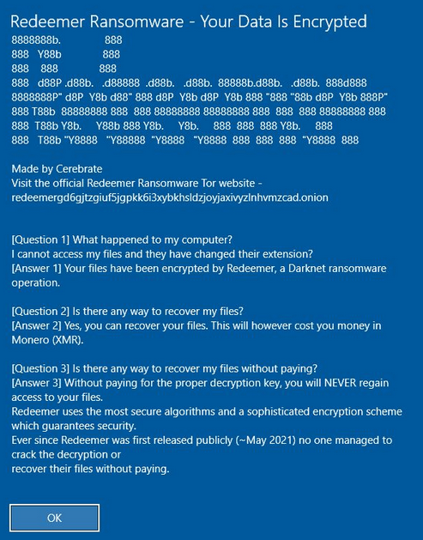
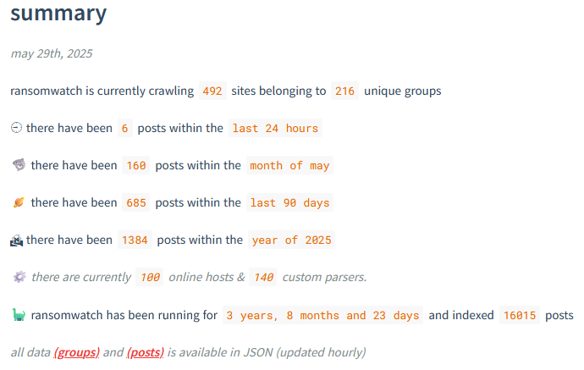
DEUTSCHLAND - BIER, WURST UND SCHWACHSTELLEN
Common Attack Vectors - Malware - Ransomware
Redeemer Ransomware | Ransomwatch
Page 16
Notes:
https://images.shodan.io/?query=ransomware
https://www.bleepingcomputer.com/news/security/french-hospital-chc-sv-refuses-to-pay-lockbit-extortion-demand/
https://www.darkreading.com/cyberattacks-data-breaches/hubris-may-have-caused-lockbit-s-downfall

Slide 17
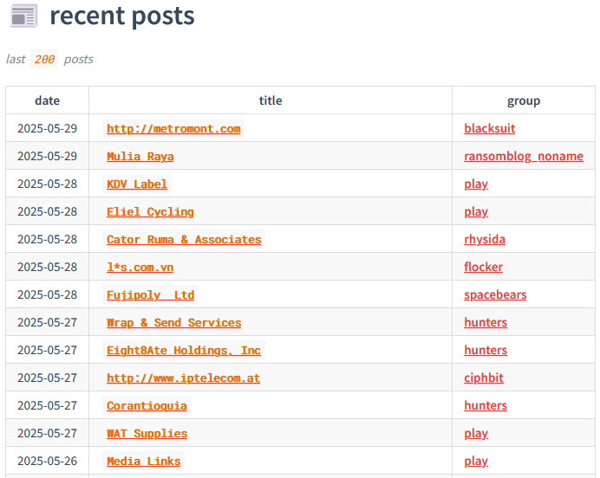

DEUTSCHLAND - BIER, WURST UND SCHWACHSTELLEN
Common Attack Vectors - Malware - Ransomware
Ransomwatch | NoMoreRansom
Page 17
Notes:
https://ransomwatch.telemetry.ltd/#/recentposts
https://www.nomoreransom.org/en/index.html

Slide 18
DEUTSCHLAND - BIER, WURST UND SCHWACHSTELLEN
German landscape
Definition and Statistics
Page 18

Slide 19
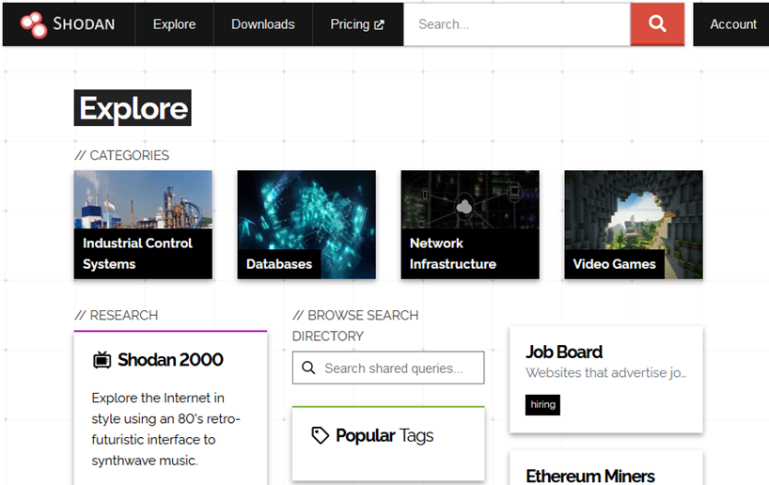
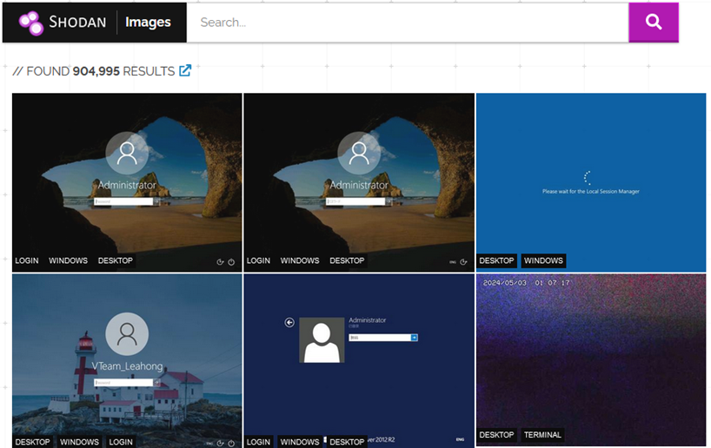
DEUTSCHLAND - BIER, WURST UND SCHWACHSTELLEN
Germany - Shodan.io - Search Engine for Internet Of Things
Explore | Images
Shodan Queries (link)
Page 19

Slide 20
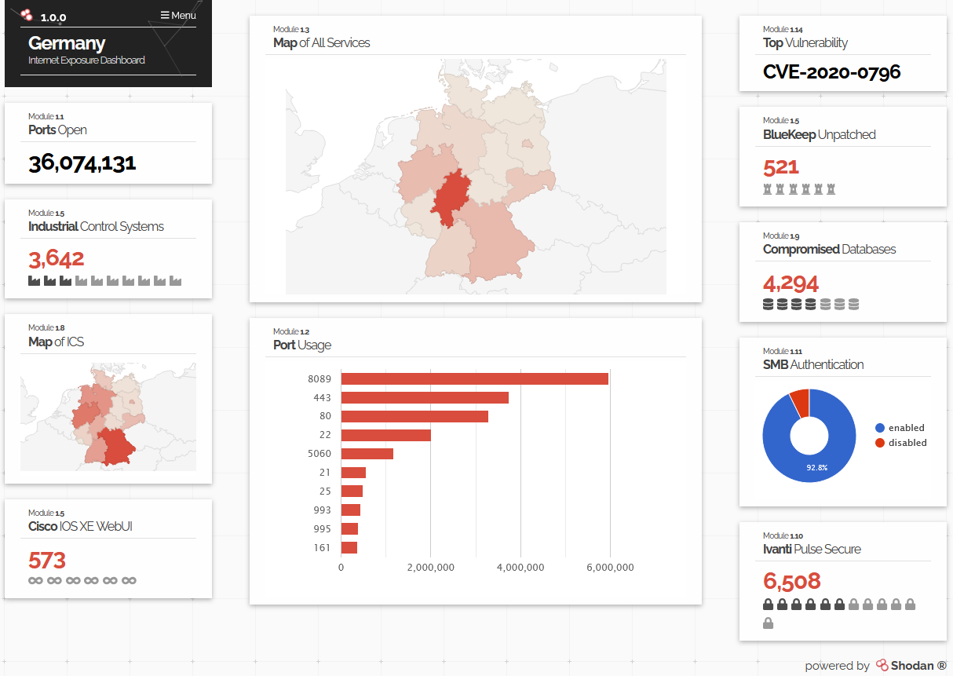
DEUTSCHLAND - BIER, WURST UND SCHWACHSTELLEN
Germany - Shodan.io - Search Engine for Internet Of Things
Internet Exposure Observatory
Page 20
Notes:
https://exposure.shodan.io/#/DE

Slide 21
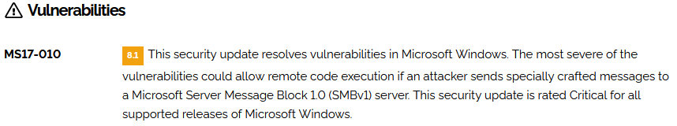
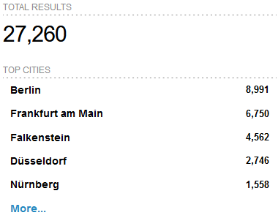
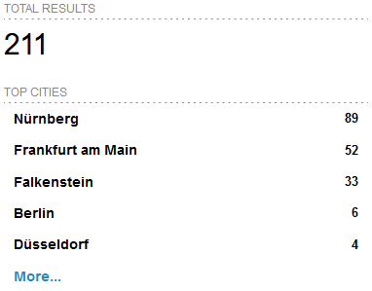
DEUTSCHLAND - BIER, WURST UND SCHWACHSTELLEN
Germany - Shodan.io - Search Engine for Internet Of Things
Top in Germany - SMBGhost - CVE-2020-0796 | EternalBlue - MS17-010 - CVE-2017-0144
Page 21
Notes:
https://www.shodan.io/search?query=vuln%3ACVE-2020-0796+country%3Ade
https://www.shodan.io/search?query=vuln%3Ams17-010+country%3Ade

Slide 22
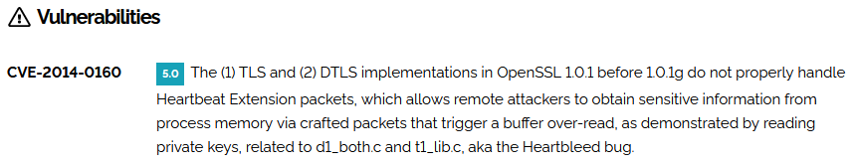
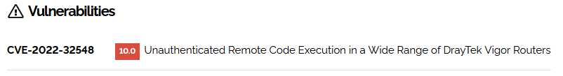
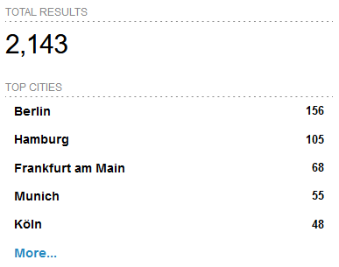
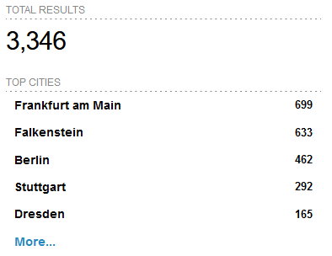
DEUTSCHLAND - BIER, WURST UND SCHWACHSTELLEN
Germany - Shodan.io - Search Engine for Internet Of Things
Heartbleed - CVE-2014-0160 | Logjam - CVE-2022-32548
Page 22
Notes:
https://www.shodan.io/search?query=vuln%3ACVE-2014-0160+country%3Ade
https://www.shodan.io/search?query=vuln%3ACVE-2022-32548+country%3Ade

Slide 23
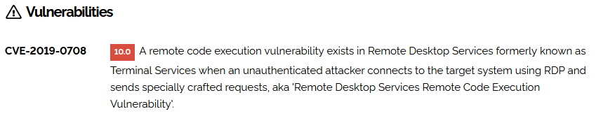
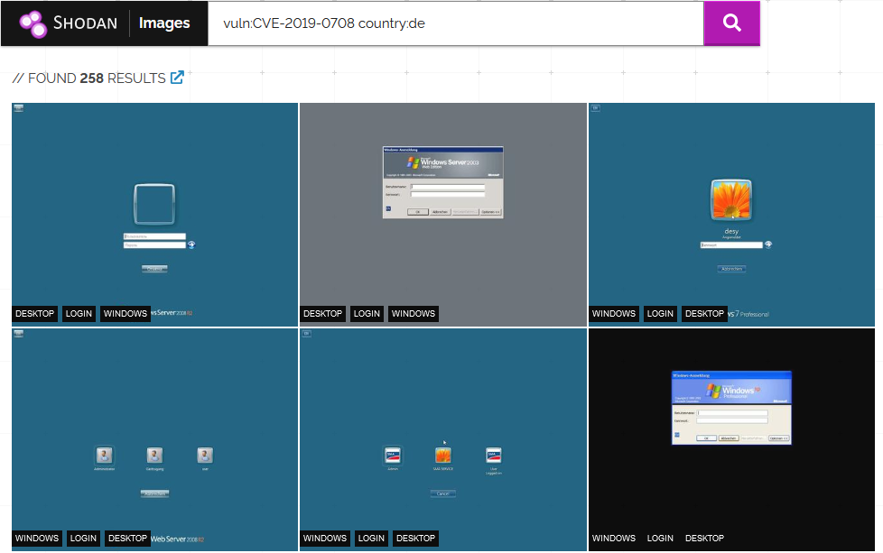
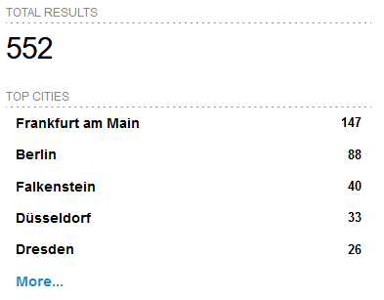
DEUTSCHLAND - BIER, WURST UND SCHWACHSTELLEN
Germany - Shodan.io - Search Engine for Internet Of Things
BlueKeep - CVE-2019-0708
Page 23
Notes:
https://www.youtube.com/watch?v=rAMKgrzO9KQ
https://www.shodan.io/search?query=vuln%3ACVE-2019-0708+country%3Ade
https://images.shodan.io/?query=vuln%3ACVE-2019-0708+country%3Ade

Slide 24
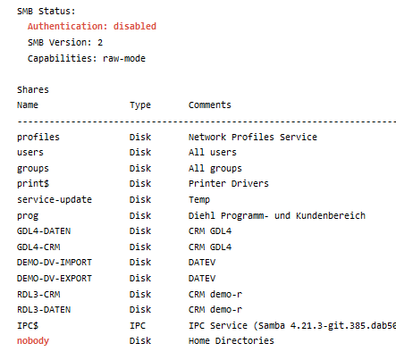
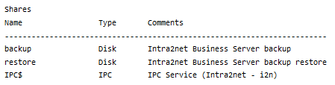
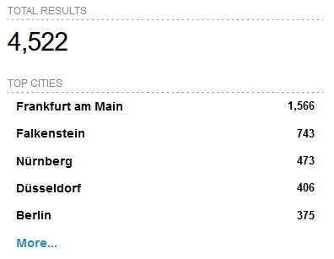
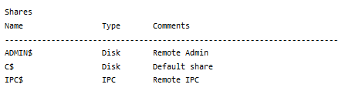
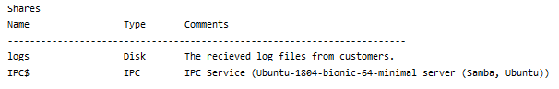
DEUTSCHLAND - BIER, WURST UND SCHWACHSTELLEN
Germany - Shodan.io - Search Engine for Internet Of Things
Shared Folders
Page 24
Notes:
https://www.shodan.io/search?query=country%3Ade+port%3A%22445%22+Authentication%3A+%22disabled%22

Slide 25
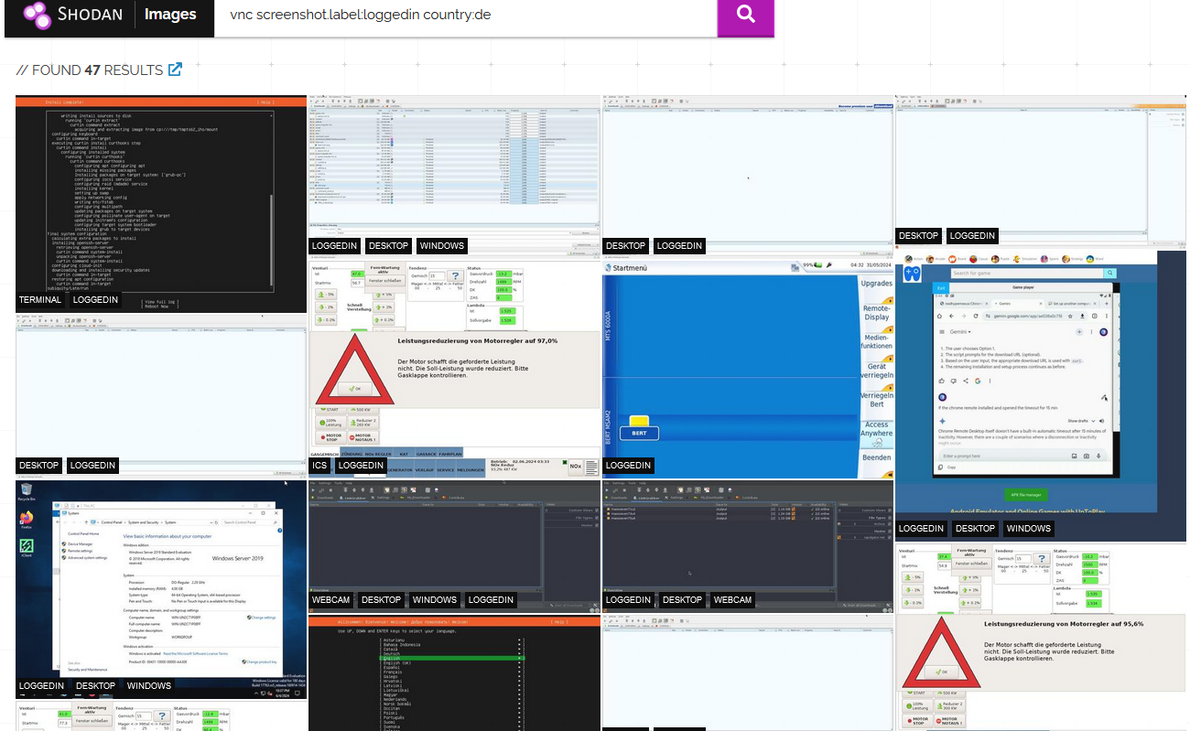
DEUTSCHLAND - BIER, WURST UND SCHWACHSTELLEN
Germany - Shodan.io - Search Engine for Internet Of Things
Logged In Remote Access
Page 25
Notes:
https://images.shodan.io/?query=vnc+screenshot.label%3Aloggedin+country%3Ade

Slide 26
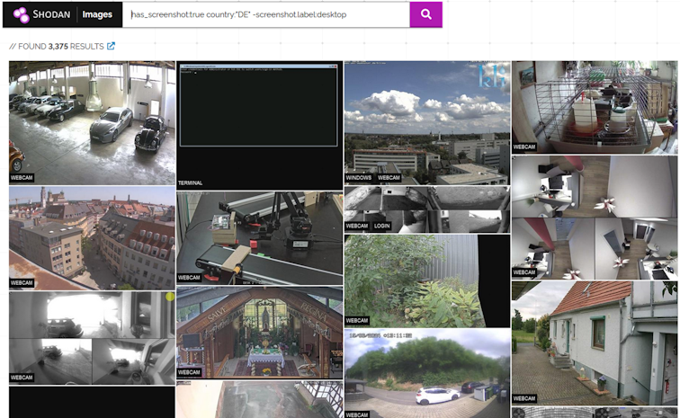
DEUTSCHLAND - BIER, WURST UND SCHWACHSTELLEN
Germany - Shodan.io - Search Engine for Internet Of Things
Webcam
Page 26
Notes:
https://images.shodan.io/?query=has_screenshot%3Atrue+country%3A%22DE%22+-screenshot.label%3Adesktop&language=en

Slide 27
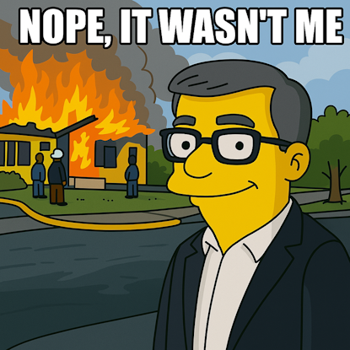
DEUTSCHLAND - BIER, WURST UND SCHWACHSTELLEN
THANK YOU
Q & A
Page 27

